Slide 1
Self-introduction and Research Progress
Jul 16, 2018
Xingyu Su

Slide 2
Self-introduction

Slide 3
Self-introduction
Name: Xingyu Su (“苏星宇” in Chinese)
Email:
suxy15tsinghua@gmail.com
suxy15@mails.tsinghua.edu.cn
Phone:
1 (919) 638 2702
Website: suxy.info
Education: 2015-present in Tsinghua University
Undergraduate in Department of Energy and Power Engineering
Minor in Computer Technology and Application
Notes:
Here are some basic information of me and you can see more at my personal site: suxy.info

Slide 4
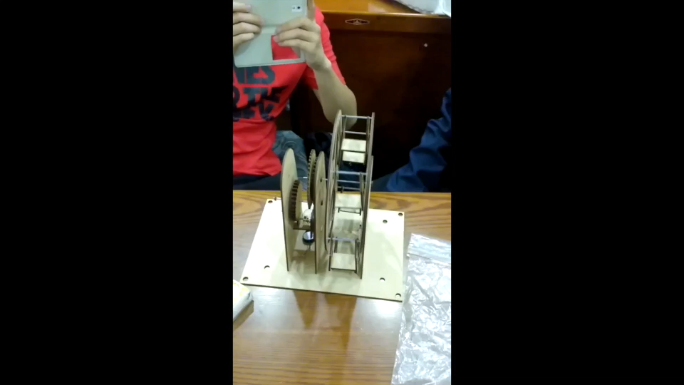
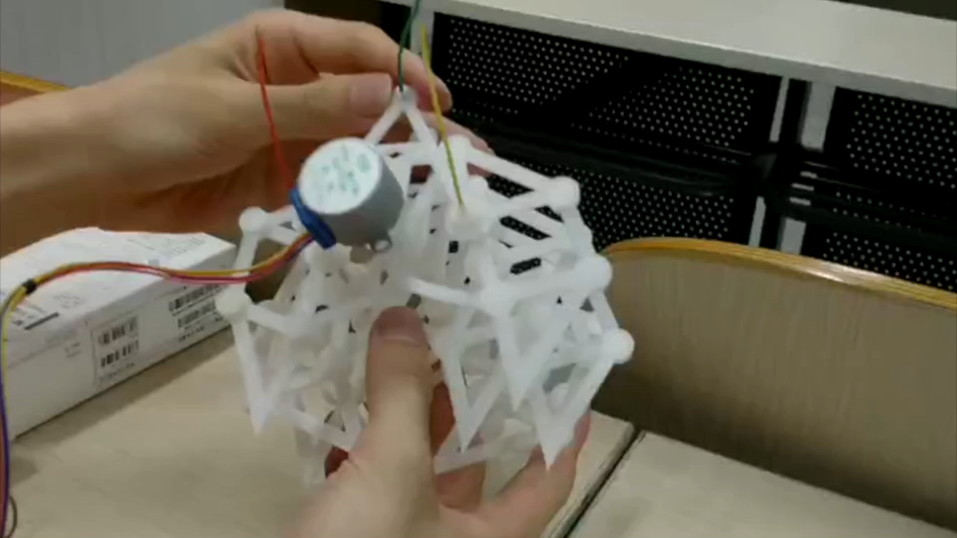
3D printing, Laser cutting
Notes:
I admire the spirit of geeks and dream of becoming a true geek.
The two are simple projects of 3D printing and laser cutting.

Slide 5
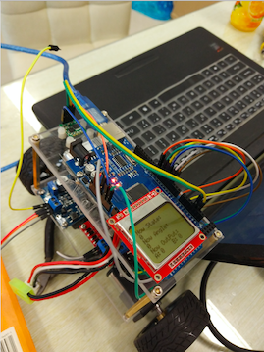
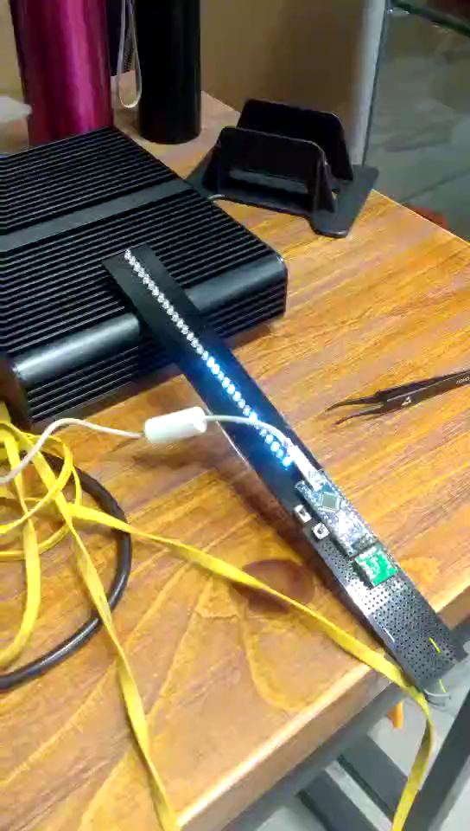
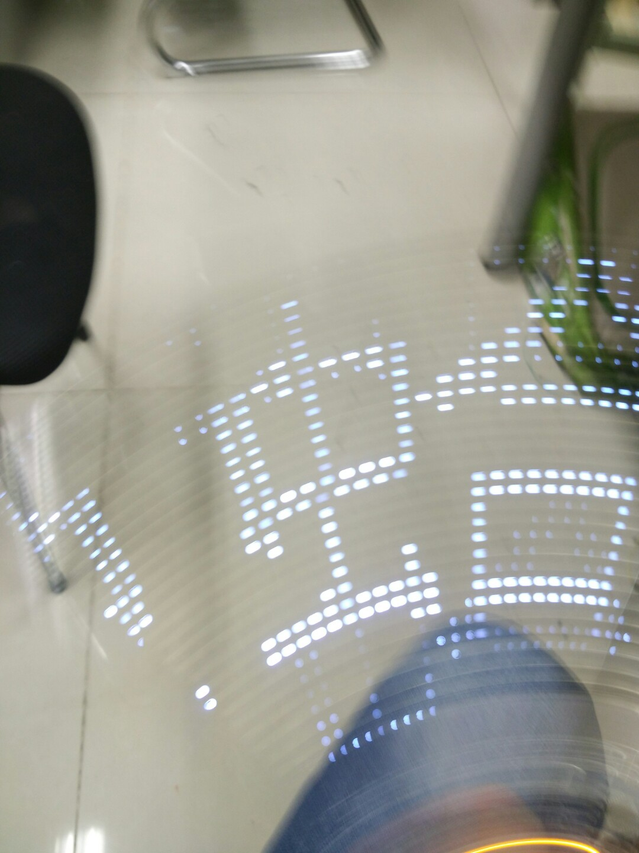
Self-balance scooter, POV display
POV: Persistence Of Vision
Notes:
And I have some hardware using experience, such as arduino, single chip microcomputer and raspberry pi.

Slide 6
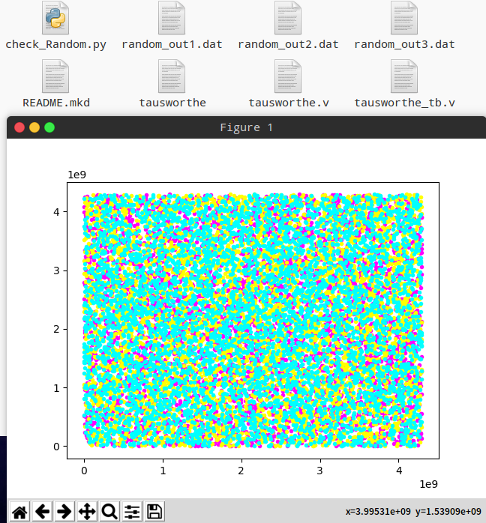
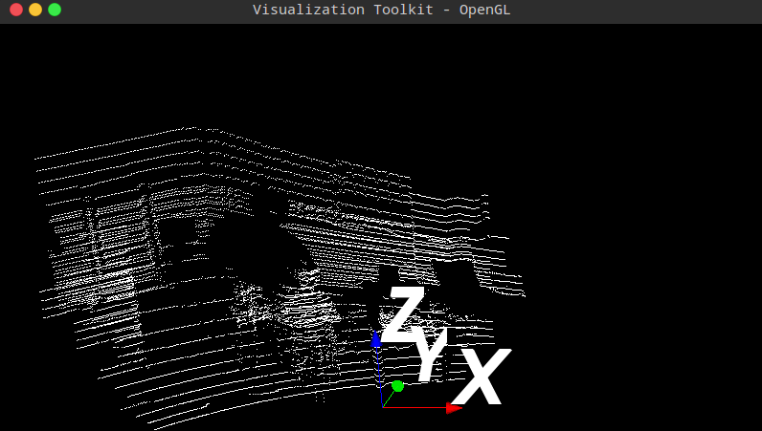
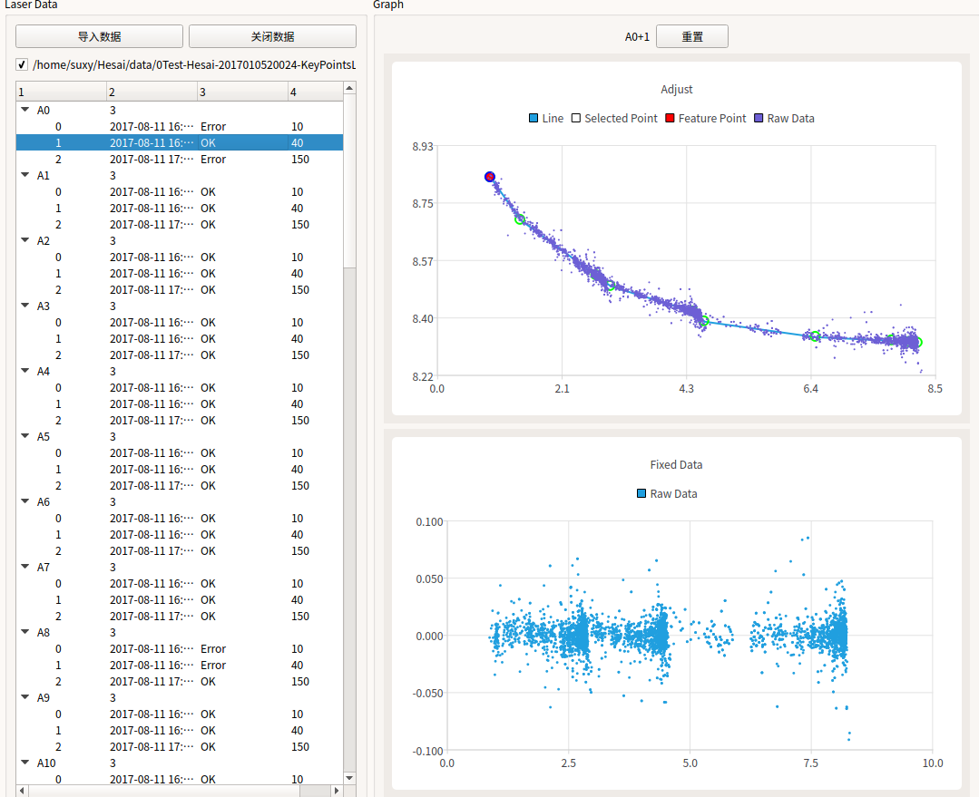
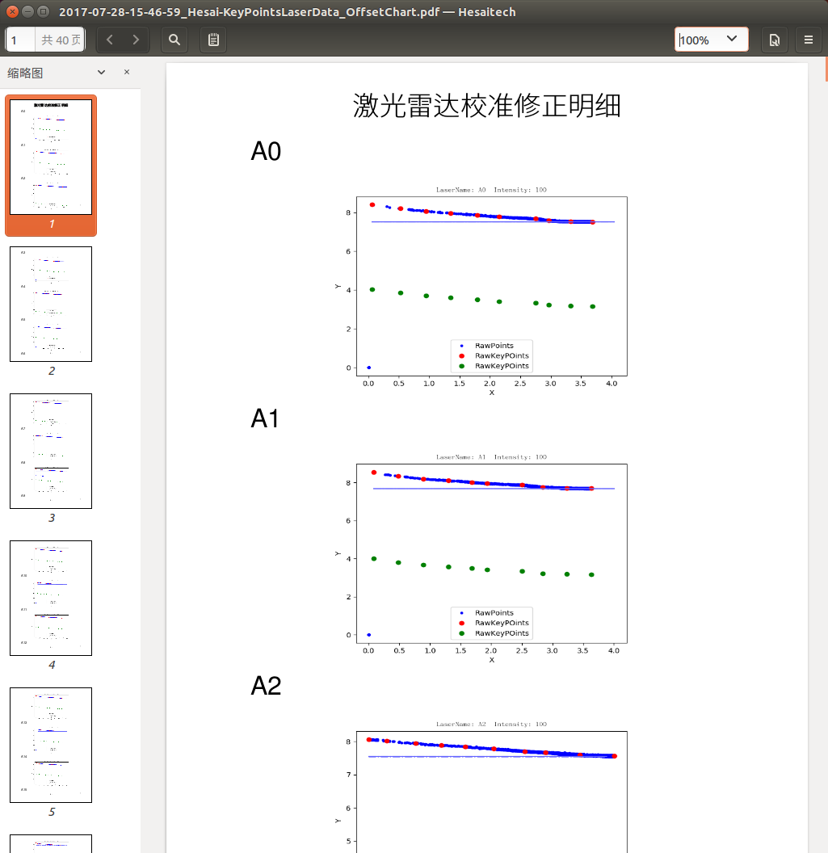
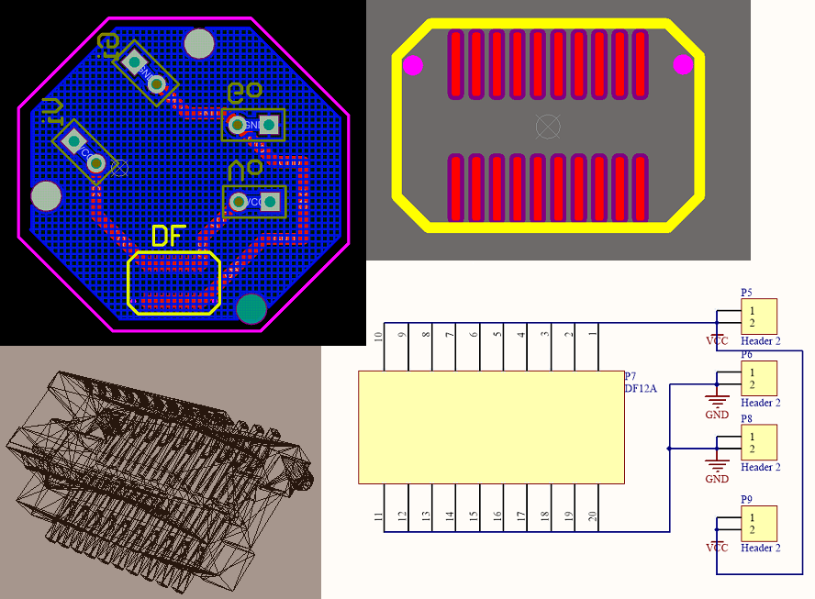
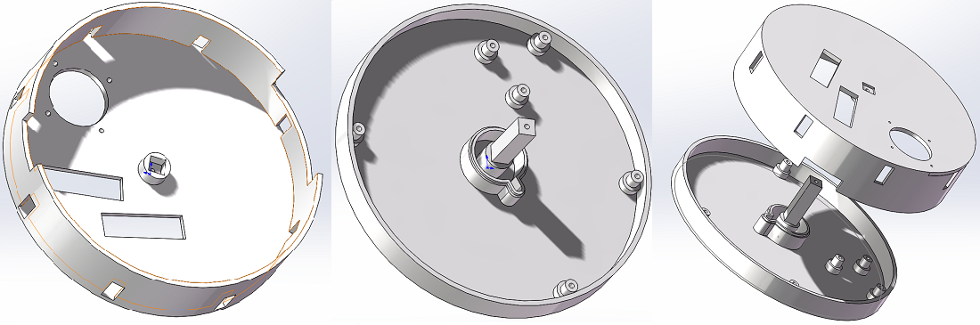
2017 Intern @Hesai Photonics Technology
Notes:
Last summer I worked as an intern in a start-up company in Shanghai, and learned a lot of skills.
Lidar Calibration by Python+Qt
Power adapter board by Altium Designer
Document generator by Python
FPGA Random Generator by Verilog
3D Point cloud Visualization by Python+VTK
Testing Container by Solidworks

Slide 7
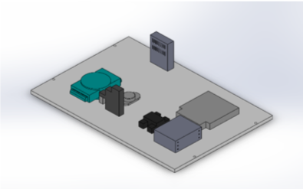
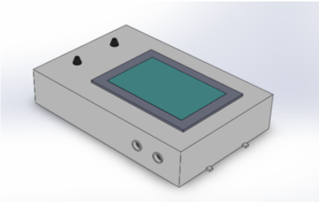
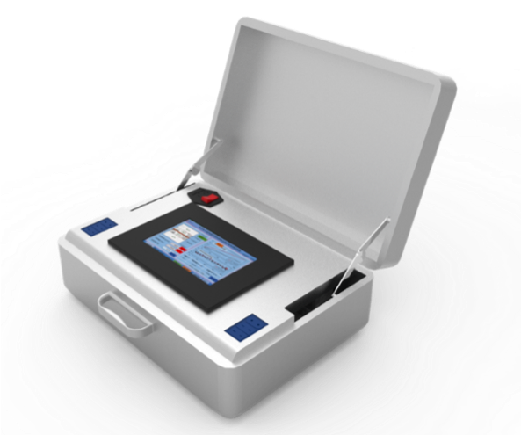
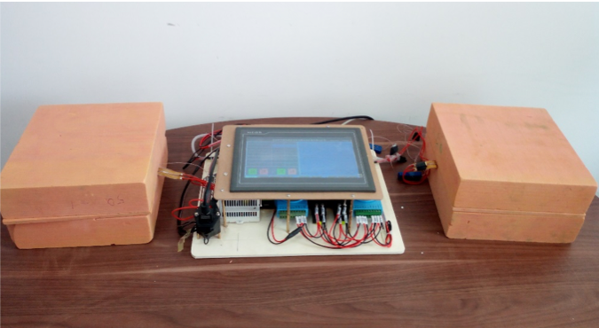
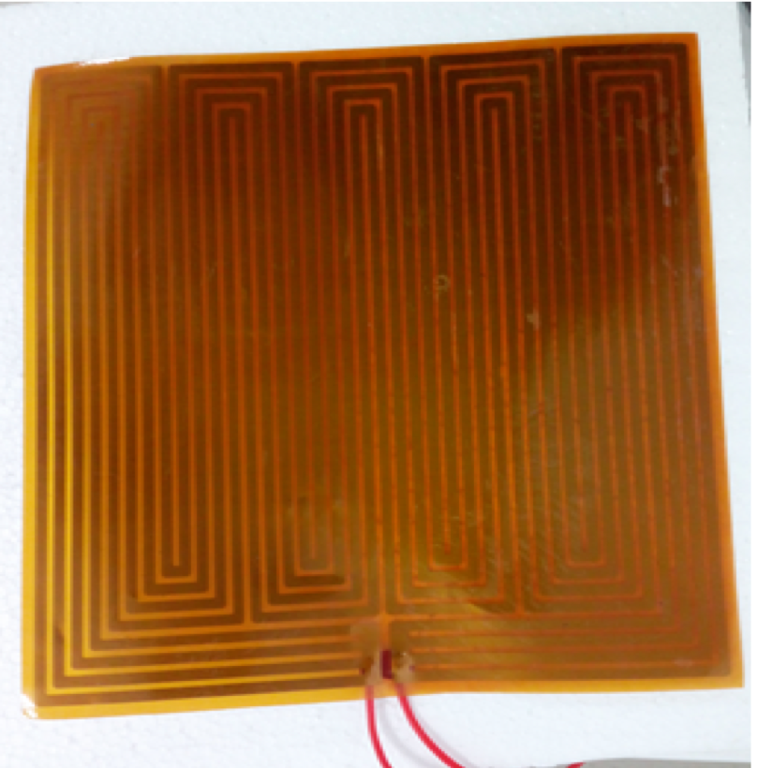
Portable construction material thermal property measuring instrument
Notes:
And here is my first research project.
It’s an experiment equipment and my part was to do experiment and analysis data.

Slide 8
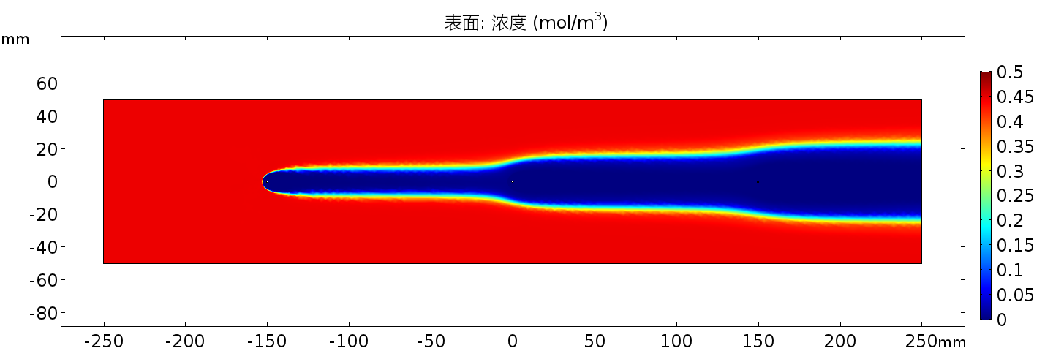
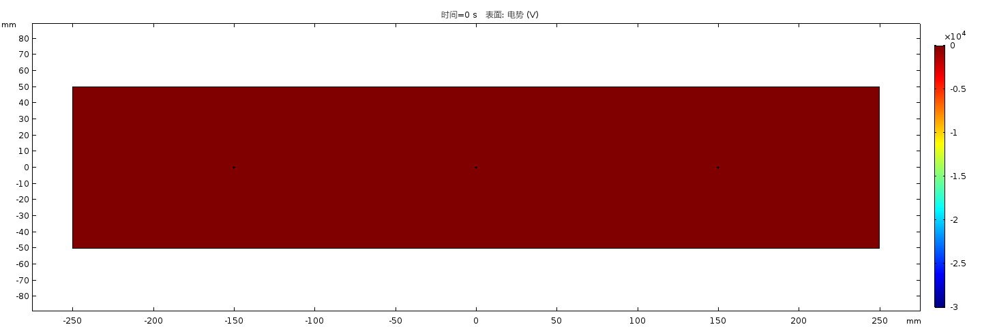
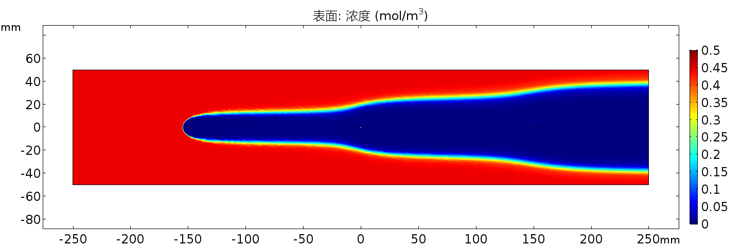
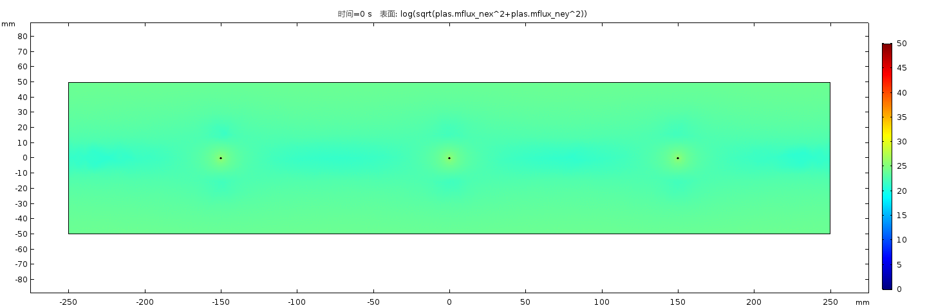
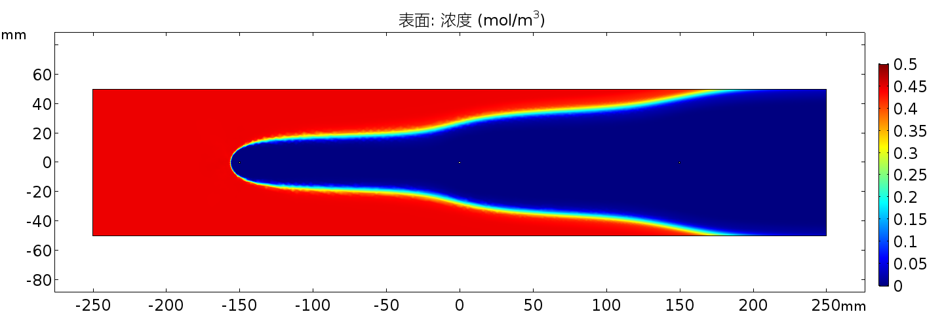

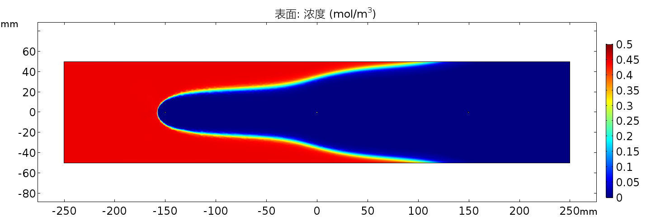
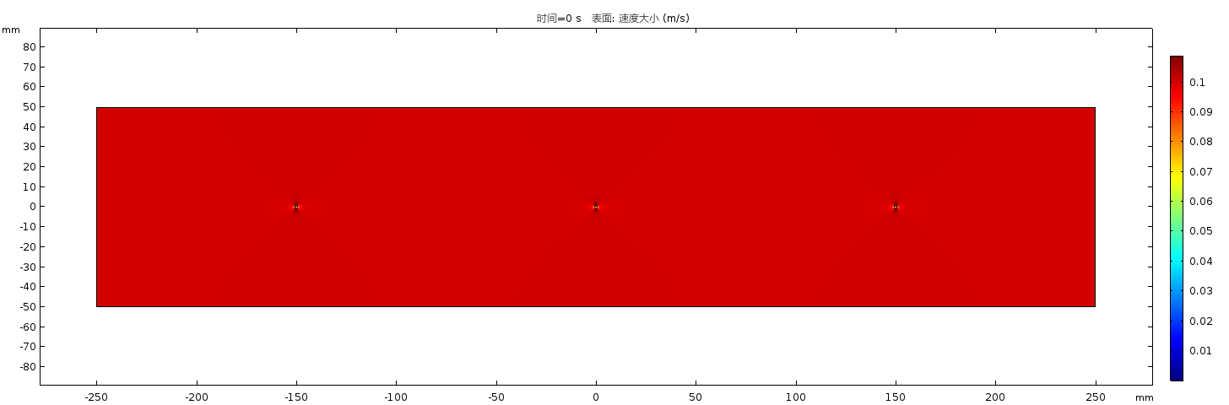
Simulation of electrostatic precipitators
Notes:
This was a simulation project by COMSOL.

Slide 9
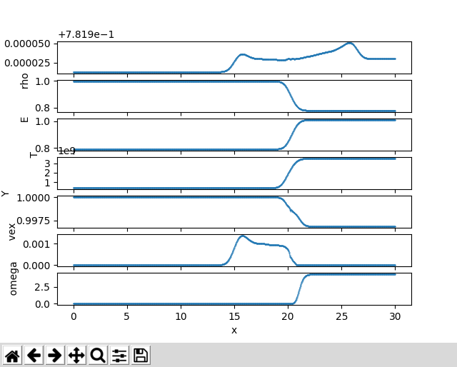
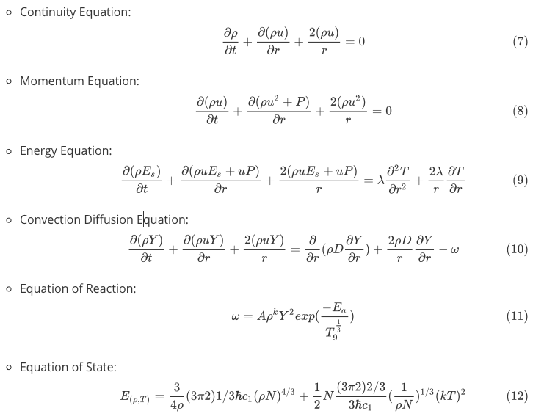
Simulation of spherical inward propagating Carbon-Oxygen flame (IPF) of type Ia supernova
Notes:
This is a project that I am still working on.
Simulate by Fortran & CPP

Slide 10
Research Progress
Notes:
Here is some research progress of these days

Slide 11
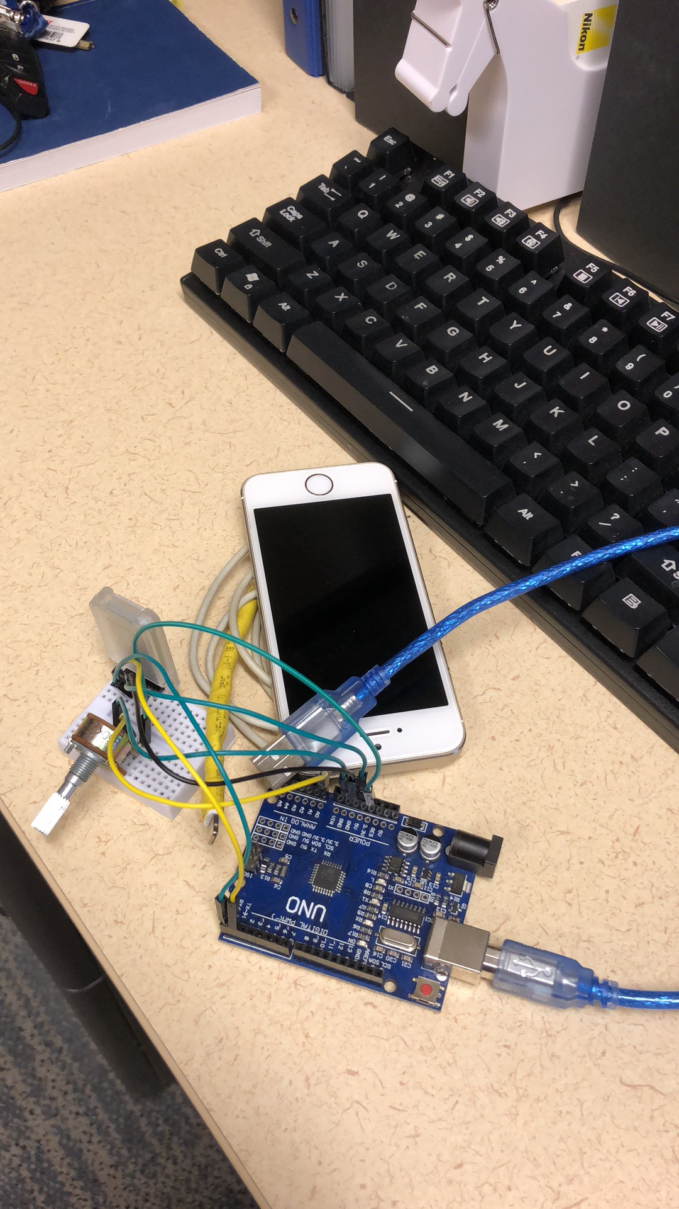
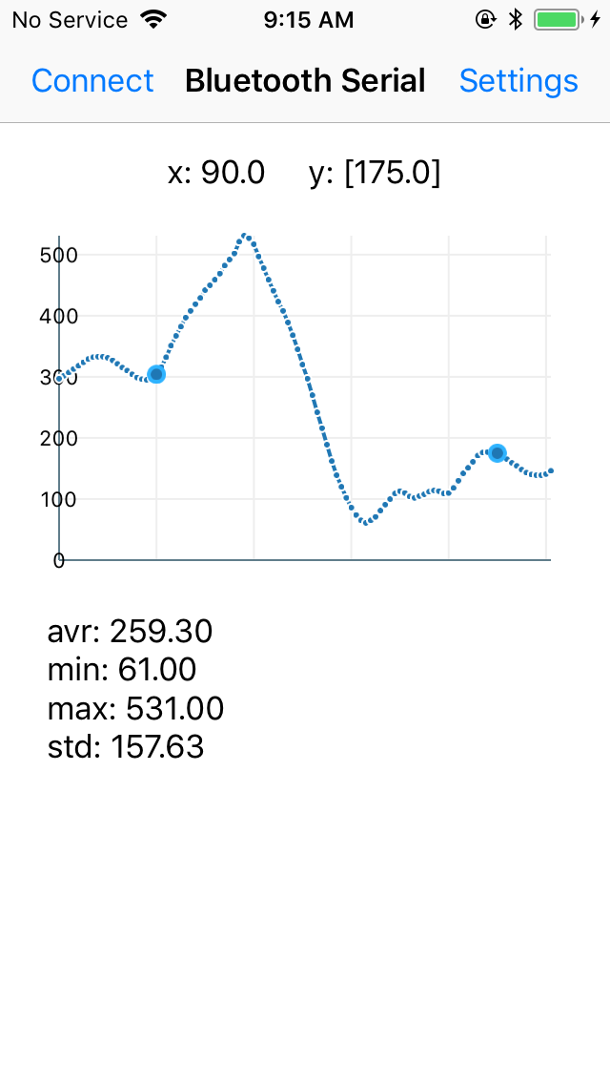
iOS BLE Application
Add some functions
Select 2 points
calculate statistical information and show
Revise the selected points’ X value error
Improve performance when selecting 2 points
BLE: Bluetooth Low Energy
Notes:
First is the application of iOS BLE communicating and illustrating.
I read all the code and modified some for my part.
It’s a bit simple and almost done.

Slide 12
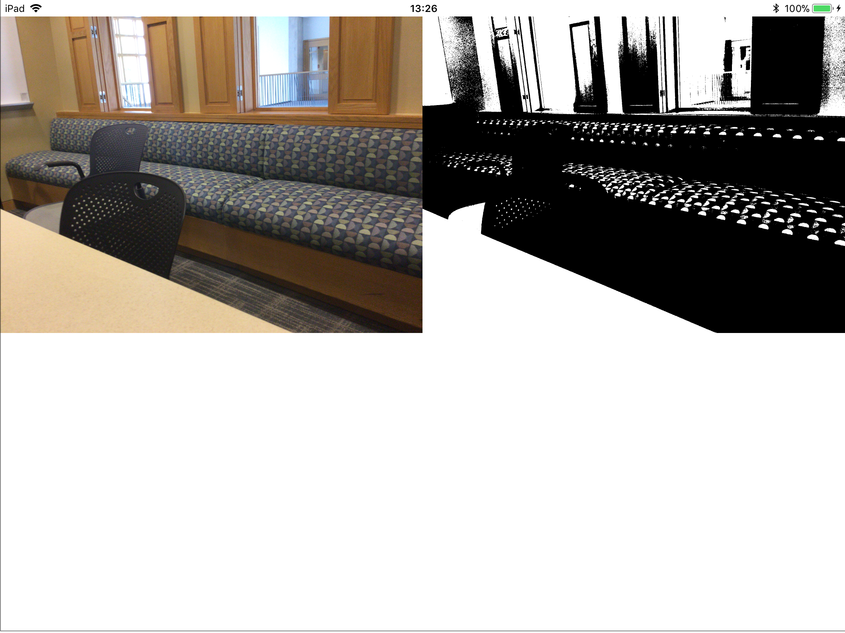
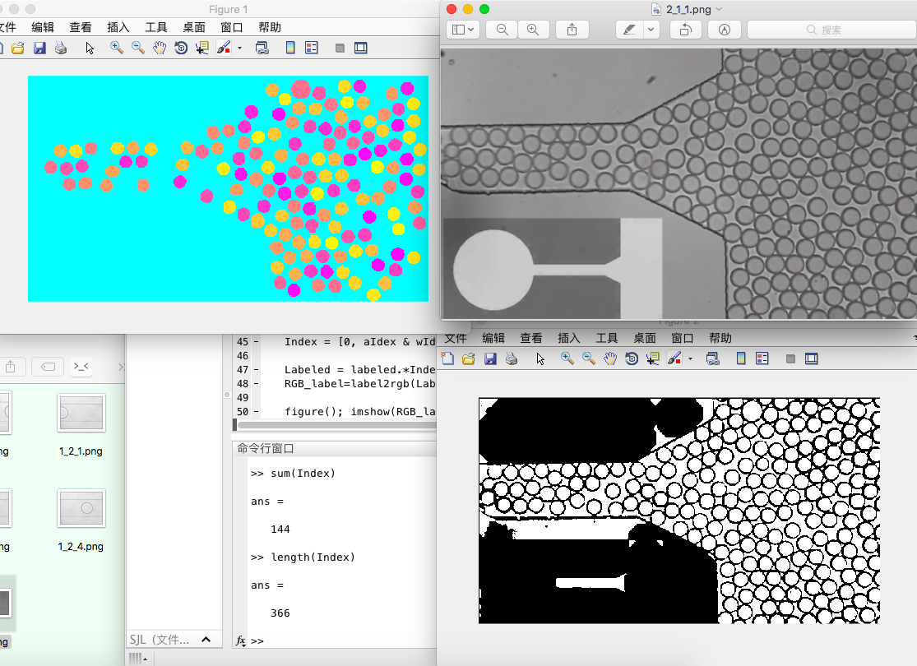
iOS Droplet Counter
Learning:
OpenCV learning
Makefile learning
Tests:
Camera Test
Matlab Test
OpenCV Test
Notes:
And Geonsoo arranged me another project. Droplet tracking by camera of iPhone.
After a period of learning and testing, the basic functions have been implemented.
One way I used is to detect the connected domain after image processing and check every region by it’s size and shape. You can see a demo of Matlab in the downside of this slide.

Slide 13
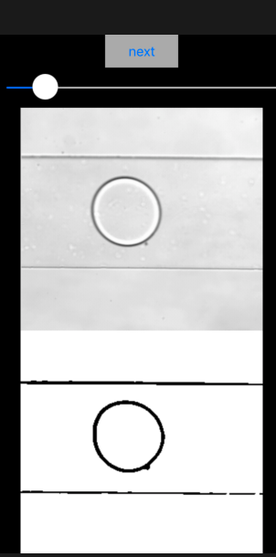
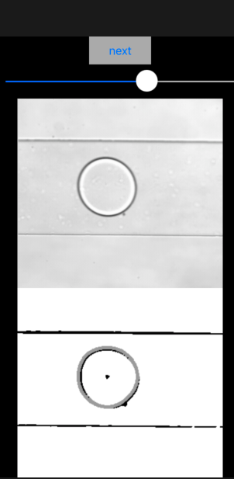
iOS Droplet Counter
Circle Hough Transform
Assume circle radius by provided range
Intersection point of every circle from every point corresponding to the center point of an original circle
Once center point fixed, adjusting radius to get the best result
Notes:
And the other way I used is a ready-made algorithm called Circle Hough Transformation.

Slide 14
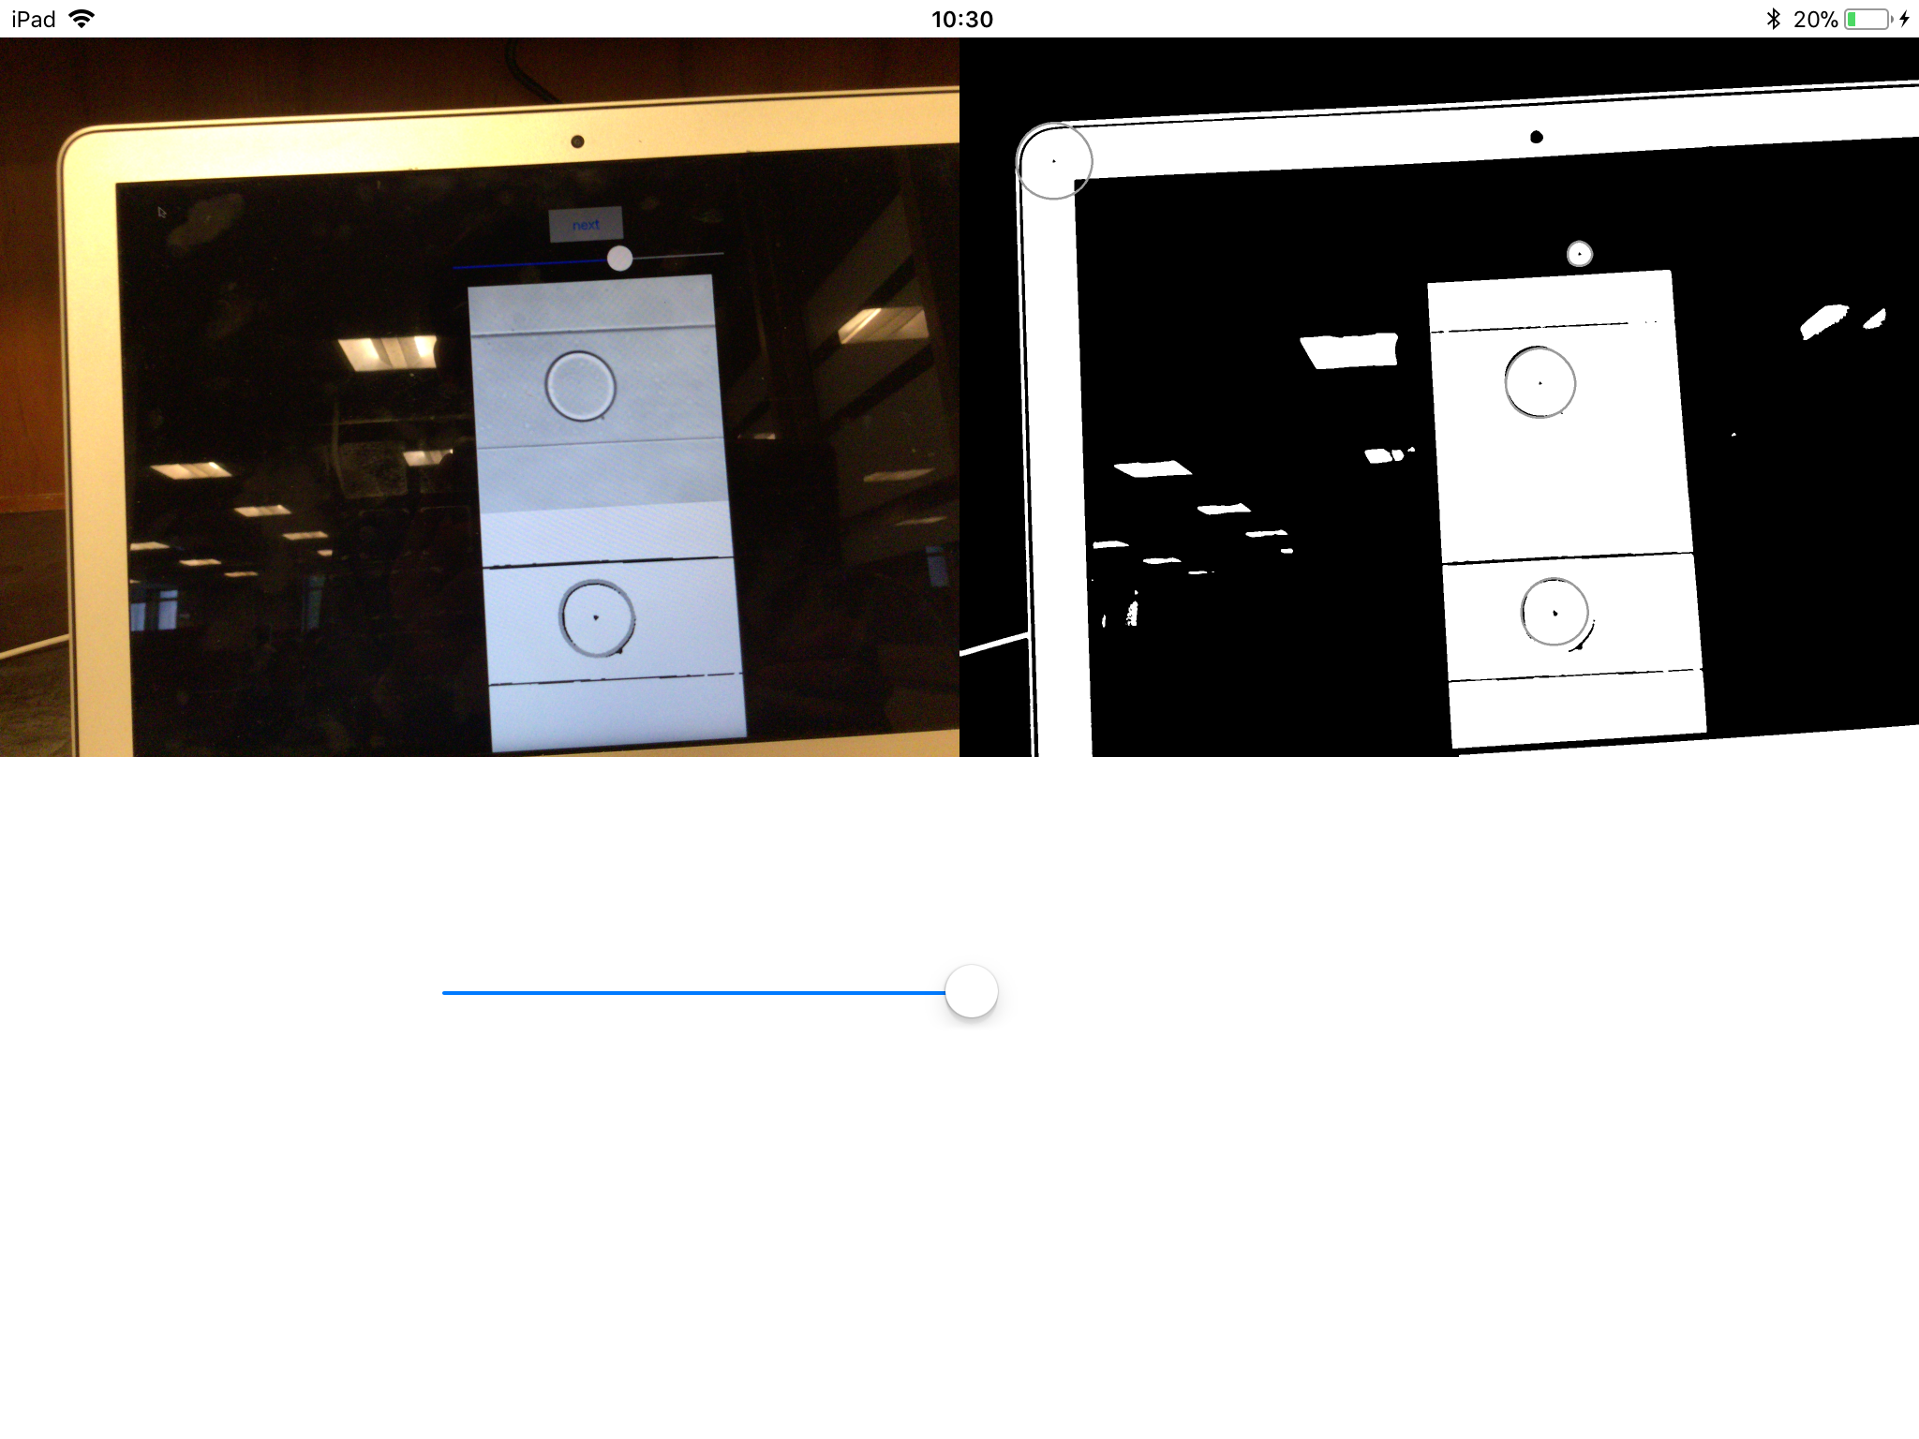
iOS Droplet Counter
Wrong
Correct
Notes:
But there will be some wrong results due to the unstable environment.

Slide 15
Problems
[x] Unable to destroy point layer
[x] Memory Leak
[x] Multi circles detecting by Hough transform
[ ] Algorithm Complexity
[ ] Stable environment required
Notes:
And the Hough Transform is time costly which means we can’t get ideal framerate and the tracking will be impossible.
So my next week plan is mainly about testing in real runner environment and improving algorithm.

Slide 16
Next week plan
Test code with lens and runner
Improve algorithm
Complete document
Notes:
And yes, writing documents.

Slide 17
Appendix
HM10 Serial
OpenCV for iOS Book
Makefile
OpenCV Tutorial
Notes:
Here are some reference.

Slide 18
Thanks
Notes:
Thanks all of you for watching and listening.

